Slide 1
CHAPTER TWO
PERCENTAGE CALCULATION

Slide 2
Objective
At the end of this chapter, the students will be able to
Define the expressions percent weight-in-volume, percent volume-in -volume, and percent weight -in-weight.
Perform calculations in percent weight-in-volume, percent volume-in -volume, and percent weight -in-weight expressions.
Apply % w/v, % v/v and % w/w expressions in Pharmacy practice.

Slide 3
PERCENTAGE
Percentage
The term percent and its corresponding sign (%) mean ‘
‘by the hundred’’ or ‘‘in a hundred,’’
Percentage means ‘‘rate per hundred’’;
So, 50 percent (or 50%) and a percentage of 50 are equivalent expressions.

Slide 4
Conti…
Percent may also be expressed as a ratio,or decimal fraction.
eg,50% means 50 parts in 100 of the same kind or 50⁄100 or 0.50.
Percent, therefore, is simply another fraction that its numerator is expressed but its denominator is left understood.

Slide 5
Conti…
For the purposes of computation, percents are usually changed to equivalent decimal fractions.
by dropping the percent sign (%) and dividing the expressed numerator by 100.
Thus, 12.5% =12.5/100,or 0.125
Reverse process (changing a decimal to a percent),
the decimal is multiplied by 100 and the percent sign (%) is affixed.

Slide 6
Percentage Preparation
The percentage concentrations of active and inactive constituents in various types of pharmaceutical preparations are defined as follows by the United States Pharmacopeia.

Slide 7
Weight –in Volume: Expresses the number of grams of a constituent in 100 mL of solution or liquid preparation
- Expressed as: % w/v.
Volume-in-Volume :Expresses the number of milliliters of a constituent in 100 mL of solution or liquid preparation.
- Expressed as: % v/v.
Weight-in-Weight : expresses the number of grams of a constituent in 100 g of solution or preparation.
- Expressed as: % w/w.

Slide 8
Conti…
For solutions or suspensions of solids in liquids, percent weight-in-volume;
• For solutions of liquids in liquids, percent volume-in-volume;
• For mixtures of solids or semisolids, percent weight-in-weight;
• For solutions of gases in liquids, percent weight-in-volume.

Slide 9
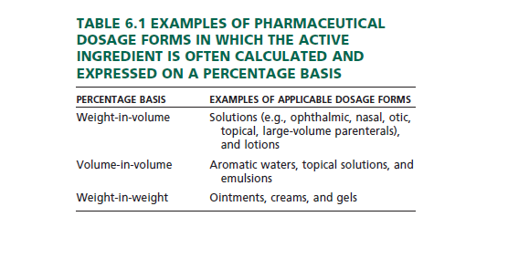
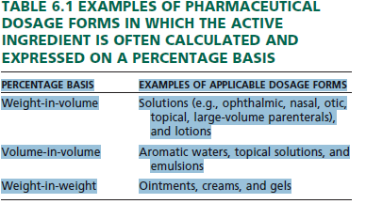
Conti…

Slide 10
Conti…
Specific gravity may be a factor in a number of calculations involving percentage concentration.
It may be necessary to convert weight to volume or, in some instances, vice versa.
g =mL × sp gr
mL =g /sp gr

Slide 11
Conti…
Although it is both obvious that one cannot multiply milliliters by specific gravity and have a product in grams, the equation ‘‘works’’ based on the assumption of;
The volume of the liquid in question is assumed to be the same volume as water for which milliliters equal grams.
So, in essence, the true equation would be:
Grams (other liquid) = Grams (of equal volume of water) × Specific gravity (other liquid )

Slide 12
Percentage Weight-in-Volume (% w/v)
In a true expression of percentage (i.e., parts per 100 parts), the percentage of a liquid preparation (e.g., solution, suspension, lotion) would represent the grams of solute or constituent in 100 g of the liquid preparation.

Slide 13
Conti…
In weight-in-volume expressions, the ‘‘correct’’ strength of a 1% (w/v) solution or liquid preparation is defined as containing 1 g of constituent in 100 mL of product.
This variance to the definition of “ true percentage is based on an assumption that;
the solution/liquid preparation has a specific gravity of 1, as if it were water.

Slide 14
Conti..
It is on this assumption that each 100 mL of solution/liquid preparation is presumed to weigh 100 g and
thus is used as the basis for calculating percentage weight-in-volume .
Volume (mL, representing grams) × % (expressed as a decimal) = grams (g) of solute or constituent

Slide 15
Examples
How many grams of dextrose are required to prepare 4000 mL of a 5% solution?
4000 mL represents 4000 g of solution
5% = 0.05
using, Volume (mL, representing grams) × % (expressed as a decimal) = grams (g) of solute or constituent
4000 g × 0.05 = 200 g, answer.

Slide 16
Conti…
How many grams of potassium permanganate should be used in compounding the following prescription?
Rx, Potassium Permanganate 0.02%
Purified Water .ad 250 mL
Sig. as directed
250 ml represent 250 g of solution
0.02% = 0.0002
by using the formula,
250 g × 0.0002 = 0.05 g

Slide 17
Example
What is the percentage strength (w/v) of a solution of urea, if 80 mL contains 12 g?
80 mL of water represent 80 g
by using formula,
80 g × %(w/v in decimal) = 12 g
% (w/v in decimal) = 12 g/80 g = 0.15
% (w/v ) = 0.15 × 100 =15 %
OR
80 (g)/12 (g) =100 (%)/x (%)
x = 15%, answer.

Slide 18
Percentage Volume-in-Volume
The percentage strength indicates the number of parts by volume of an ingredient contained in the total volume of the solution considered as 100 parts by volume.
Volume of the solution (mL) × % (expressed as a decimal) = milliliter active ingredient

Slide 19
Examples
How many milliliters of liquefied phenol should be used in compounding the following prescription ?
Rx, Liquefied Phenol 2.5% Calamine Lotion .ad 240 mL
Sig. For external use.
using, Volume (mL) × % (expressed as a decimal) = milliliter active ingredient
240 mL × 0.025 = 6 mL, answer.
Or, solving by dimensional analysis:
2.5 mL/100 mL × 240 mL =6 mL, answer

Slide 20
Conti…
What is the percentage strength v/v of a solution of 800 g of a liquid with a specific gravity of 0.800 in enough water to make 4000 mL?
800 g of water represents or measures 800 mL
800 mL /0.800 = 1000 mL of active ingredient
Using the formula,
4000 mL × % (v/v in decimal) = 1000mL
% (v/v) = 0.25 × 100 % = 25 %,answer

Slide 21
Conti…
When the volume of the active ingredient and its percentage strength(v/v) given;
it may require first determining the volume of the active ingredient from its weight and specific gravity.

Slide 22
Example
Peppermint spirit contains 10% v/v of peppermint oil. What volume of the spirit will contain 75 mL of peppermint oil?
, let the volume of solution is “X”
10% v/v = 0.1
By using the formula
75 ml = 0.1 × volume of solution (X)
X=75ml/0.1 ,
X=750 mL

Slide 23
Example
If a veterinary liniment contains 30% v/v of dimethyl sulfoxide, how many milliliters of the liniment can be prepared from 454 g of dimethyl sulfoxide (sp gr 1.10)?
454 g of water measures 454 mL
454 mL /1.10 = 412.7 mL of dimethyl sulfoxide
454 g of dimethyl sulfoxide is 412.7 mL
By using the formula,
volume of the solution(V) × 0.3 = 412.7 mL
V = 1375.66 ~ 1376 mL ...answer

Slide 24
Percentage Weight-in-Weight
True percentage or percentage by weight
Indicates the number of parts by weight of active ingredient contained in the total weight of the solution or mixture considered as 100 parts by weight.
Weight of solution (g) × % (expressed as a decimal) = weight of solute (g)

Slide 25
Example
How many grams of phenol should be used to prepare 240 g of a 5% (w/w) solution in water?
By using formula,
Weight of solution (g) × % (expressed as a decimal) =؄g of solute
240 g × 0.05 = 12 g, answer.

Slide 26
Example
How many grams of a drug substance are required to make 120 mL of a 20% (w/w) solution having a specific gravity of 1.15?
120 mL of water weighs 120 g
120 g × 1.15 = 138 g, weight of 120 mL of solution
138 g × 0.20 = 27.6 g plus enough water to make 120 mL, answer

Slide 27
Conti…
How many grams of benzocaine should be used in compounding the following prescription?
Rx, Benzocaine 2%
Polyethylene Glycol Base .ad 2 g
Make 24 such suppositories
Sig. Insert one as direct
The total weight of mixture is 2g × 24 = 48 g
2% = 0.02
By using the formula,
48 g × 0.02 = 0.96 g, answer.

Slide 28
Simple Conversions of Concentration to ‘‘mg/mL’’
Pharmacists, particularly those practicing in patient care settings, need to convert rapidly product concentrations expressed as percentage strength, or as grams per liter to milligrams per milliliter (mg/mL).
To convert product percentage strengths to mg/mL;
multiply the percentage strength, expressed as a whole number, by 10.

Slide 29
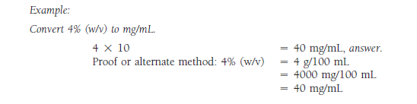
Conti…

Slide 30
Parts per Million (PPM) Parts per Billion (PPB)
The strengths of very dilute solutions are commonly expressed in terms of parts per million (ppm) or parts per billion (ppb),
The number of parts of the agent per 1 million or 1 billion parts of the whole.
Example,
Fluoridated drinking water in which fluoride has been added at levels of between 1 to 4 parts per million (1:1,000,000 to 4:1,000,000) for the purpose of reducing dental caries.

Slide 31
Conti…
Example
Express 5 ppm of iron in water in percentage strength and ratio strength.
5 ppm = 5 parts in 1,000,000 parts
= 1:200,000, ratio strength, and
= 0.0005%, percentage strength, answer

Slide 32
Conti…
The concentration of a drug additive in an animal feed is 12.5 ppm. How many milligrams of the drug should be used in preparing 5.2 kg of feed?
12.5 ppm = 12.5 g (drug) in 1,000,000 g (feed)
Thus,
1,000,000 g = 5,200 g
12.5 g X g
x = 0.065 g = 65 mg, answer.

Slide 33
Calculation of Doses and Formulas

Slide 34
Objective
At the end of this chapter, students will be able to
Define single dose, daily dose and dosage regimen.
To perform calculation with regard to patient age, patient weight and Body surface area.
Explain calibration of droppers and measurement of doses.
Perform calculation in Reducing and enlarging formulas.

Slide 35
Calculation of Doses and Formulas
Dose
is the quantitative amount administered or taken by a patient for the intended medicinal effect
The dose may be expressed as
a single dose: the amount taken at one time;
a daily dose; the amount taken in one day;
a total dose, the amount taken during the course of therapy.

Slide 36
Calculation of Doses and Formulas…
A daily dose may be subdivided and taken in divided doses, two or more times per day depending on the characteristics of the drug and the illness.
The schedule of dosing (like, four times per day for 10 days) is referred to as the dosage regimen.
The terms "average dose,“ "usual dose," and "adult dose" are based on the amount of medication needed to treat the average size adult (150-154 lbs.) with optimum effect

Slide 37
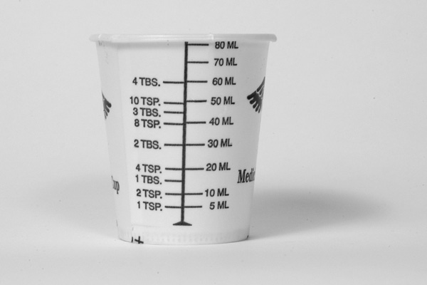
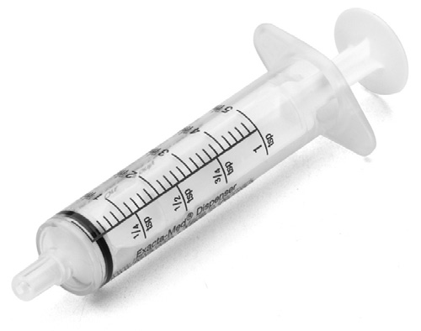
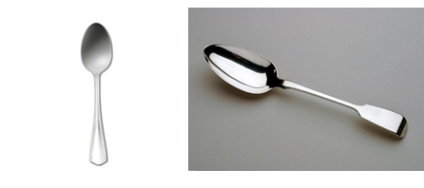
Calculation of Doses and Formulas…
Dose Measurement
In the institutional setting, doses are measured and administered by professional and paraprofessional personnel.
A variety of measuring devices may be used, including
calibrated cups
syringes
Teaspoon (~5ml) and
Tablespoon (~15ml)

Slide 38
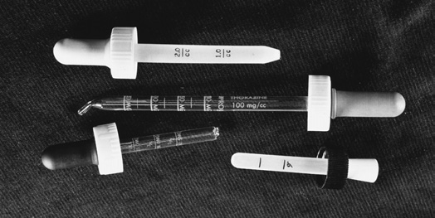

Calculation of Doses and Formulas…
The Drop as a Unit of Measure
Occasionally, the drop (abbreviated gtt) is used as a measure for small volumes of liquid medications.
A drop does not represent a definite quantity
because drops of different liquids vary greatly.
A dropper may be calibrated by counting the drops of a liquid as they fall into a graduate until a measurable volume is obtained.
The number of drops per unit volume is then established
Example:
If a pharmacist counted 40 drops of a medication in filling a graduate cylinder to the 2.5-mL mark, how many drops per milliliter did the dropper deliver?
Examples of calibrated droppers used in the administration of pediatric medications.

Slide 39
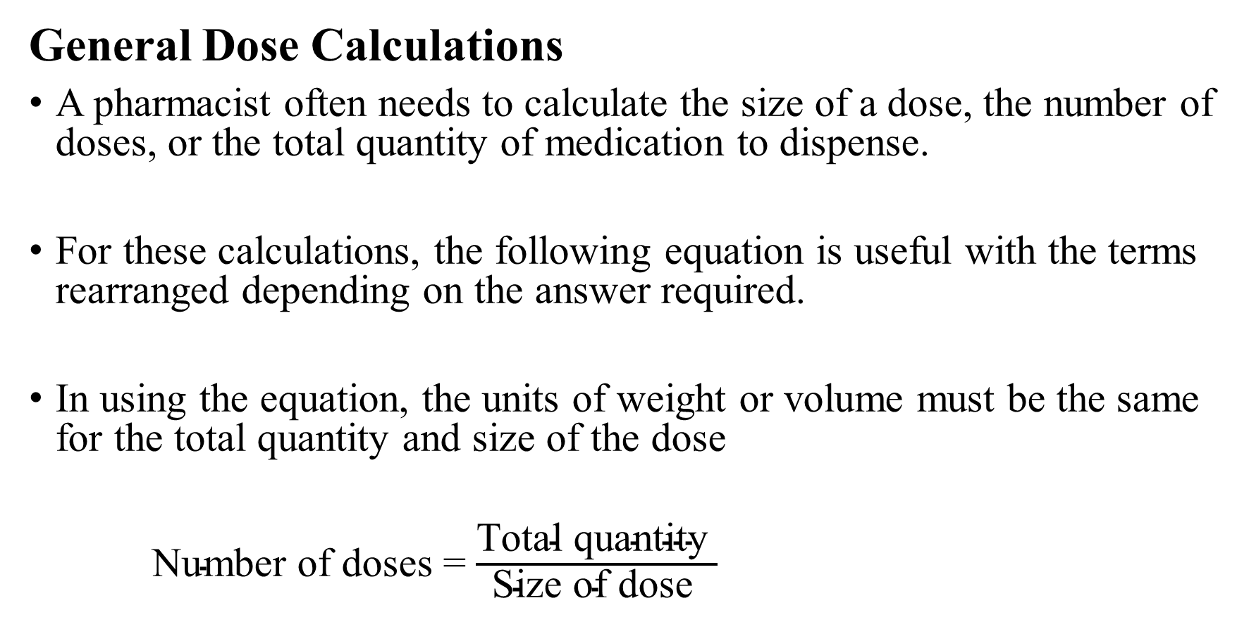
Calculation of Doses and Formulas…

Slide 40
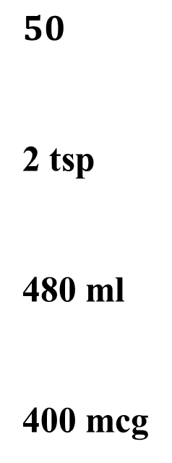
Calculation of Doses and Formulas…
Examples
If the dose of a drug is 200 mg, how many doses are contained in 10 g?
How many teaspoonfuls would be prescribed in each dose of an elixir if 180 mL contained 18 doses?
How many milliliters of a liquid medicine would provide a patient with 2 tablespoonfuls twice a day for 8 days?
If 0.050 g of a substance is used in preparing 125 tablets, how many micrograms are represented in each tablet?

Slide 41
Calculation of Doses and Formulas…
For certain drugs and for certain patients, drug dosage is determined on the basis of specific patient parameters, like:
Age,
Weight,
Body surface area, and
Nutritional and functional status.
Among patients requiring individualized dosage are:
neonates and other pediatric patients,
elderly patients with diminished biologic functions,
individuals of all age groups with compromised liver and/or kidney function (and thus reduced ability to metabolize and eliminate drug substances),
critically ill patients, and
patients being treated with highly toxic chemotherapeutic agents.

Slide 42
Calculation of Doses and Formulas…
Pediatric Patients
Pediatrics is the branch of medicine that deals with disease in children from birth through adolescence.
Neonate (newborn),
from birth to 1 month
Infant,
1 month to 1 year;
Early childhood,
From 1 year through 5 years;
Late childhood,
From 6 years through 12 years; and
Adolescence,
13 years through 17 years of age.
A neonate is considered premature if born at less than 37 weeks’ gestation

Slide 43
Calculation of Doses and Formulas…
Drug Dosage Based on Age
Neonates have immature hepatic and renal functions that affect drug response.
The elderly, in addition to diminished organ function, frequently have issues of concomitant pathologies and increased sensitivities to drugs
Age of a patient is one of the most important considerations for drug dosage modifications

Slide 44
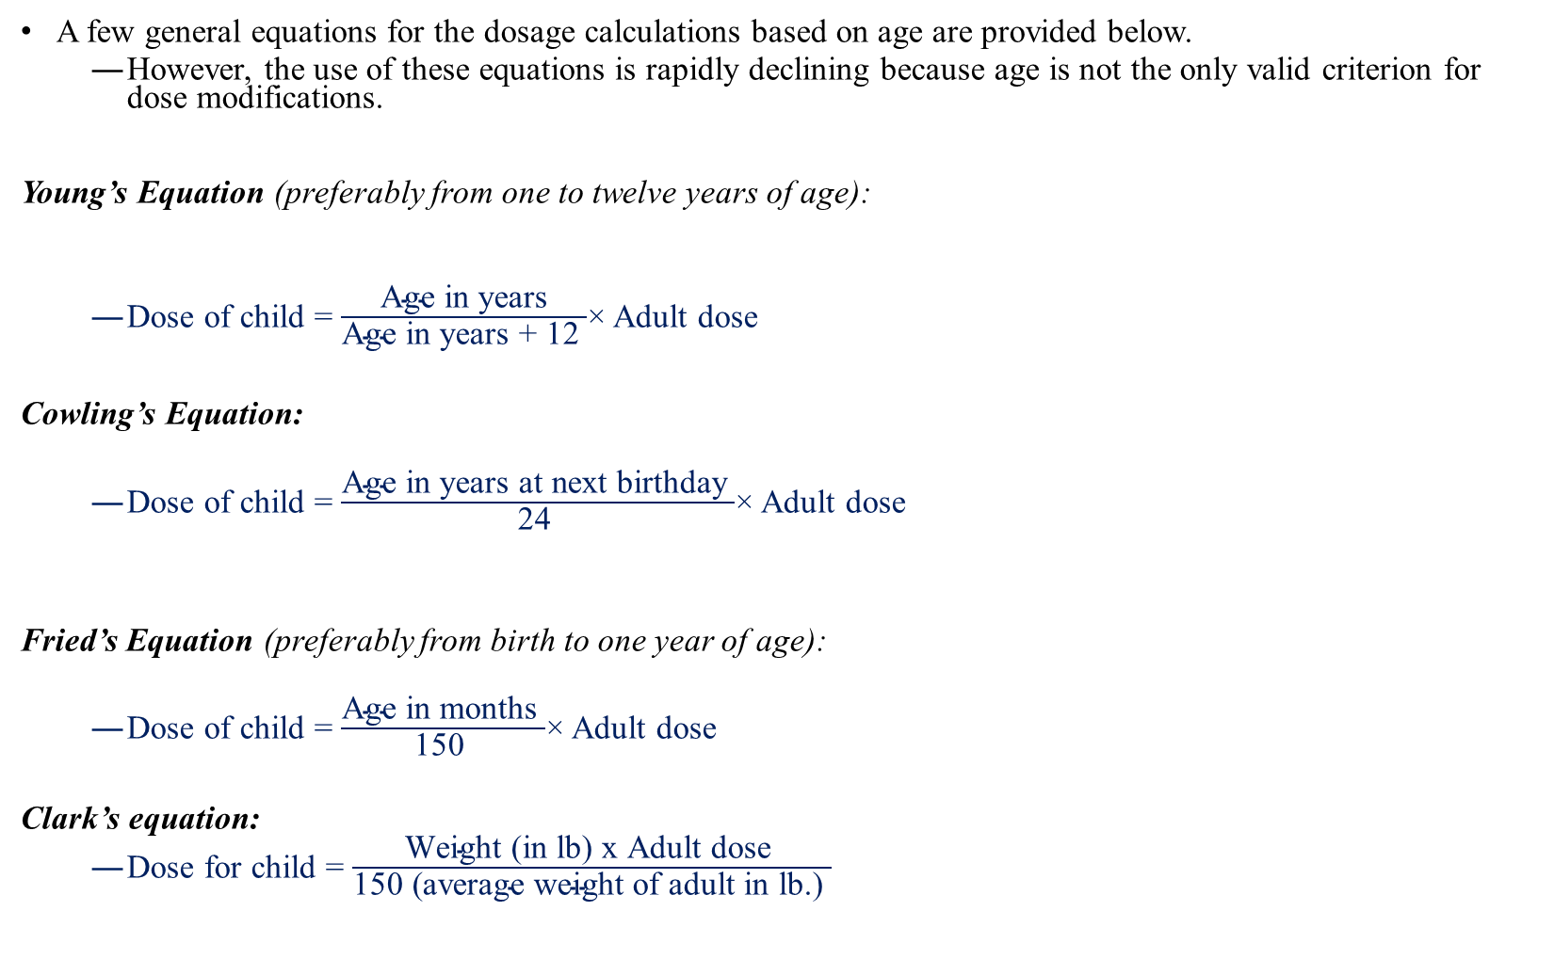
Calculation of Doses and Formulas…

Slide 45

Calculation of Doses and Formulas…
Drug Dosage Based on Body Weight
The patient’s weight is an important factor in dosing since the size of the body influences the drug’s concentration in the body fluids and at its site of action
A useful equation for the calculation of dose based on body weight is:

Slide 46
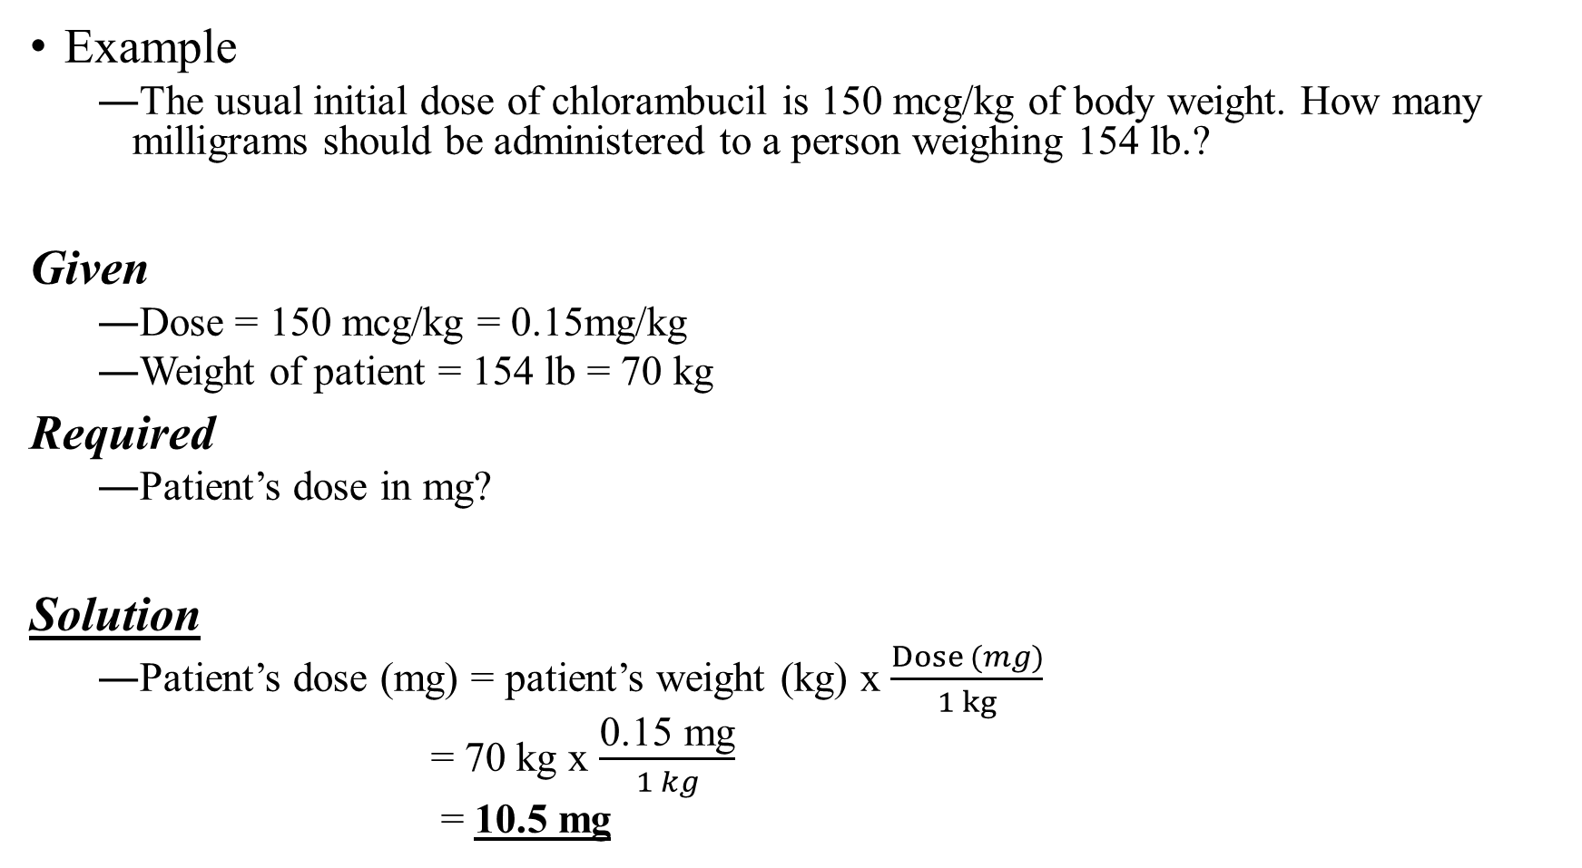

Slide 47
Calculation of Doses and Formulas…
Drug Dosage Based on Body Surface Area
The body surface area (BSA) method of calculating drug doses is widely used for two types of patient groups:
Cancer patients receiving chemotherapy and
Pediatric patients
with the general exception of neonates, who are usually dosed on a weight basis with consideration of age and a variety of biochemical, physiologic, functional, pathologic, and immunologic factors.
A useful equation for the calculation of dose based on BSA is:

Slide 48
Calculation of Doses and Formulas…
Body Surface Area (BSA) can be determined by the following methods
Nomograms
BSA equation
Nomograms
Most BSA calculations use a standard nomogram, which includes both weight and height.
The BSA of an individual is determined by drawing a straight line connecting the person’s height and weight.
The point at which the line intersects the center column indicates the person’s BSA in square meters.

Slide 49
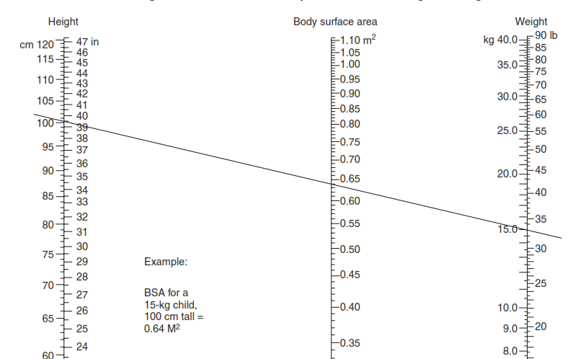
Nomogram for Determination of Body Surface Area from Height and Weight
Example
A child weighing 15 kg and measuring 100 cm in height has a BSA of 0.64 m²
Shown in Figure
2
.

Slide 50
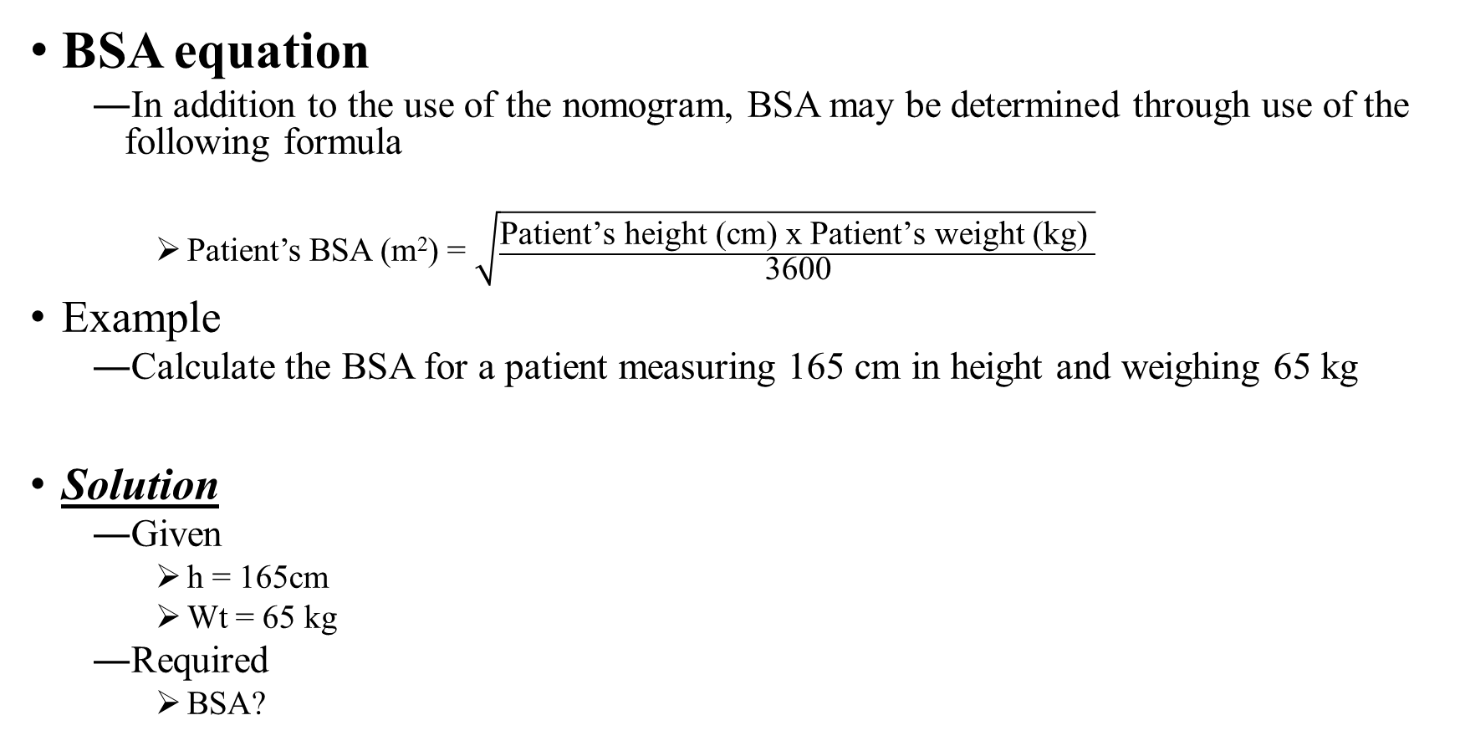
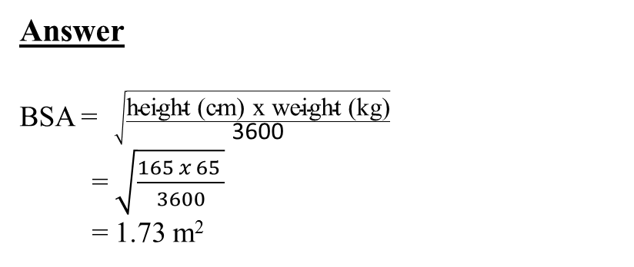
Calculation of Doses and Formulas…

Slide 51
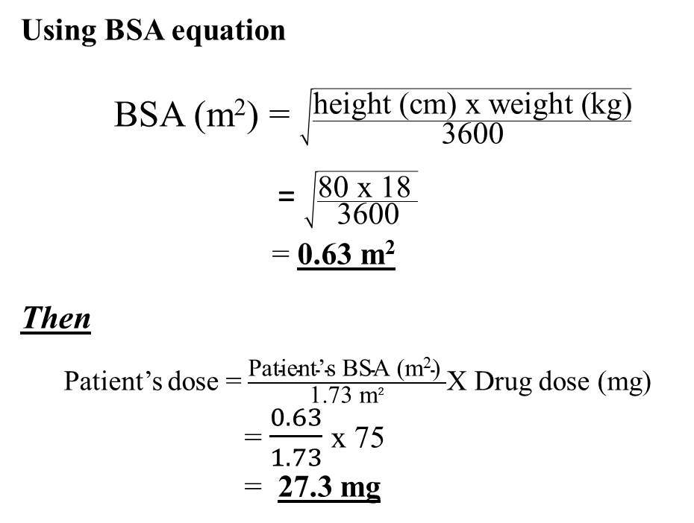
Example
If the adult dose of a drug is 75 mg, what would be the dose for a child weighing 18 kg and measuring 80 cm in height using the BSA equation?
Given
Adult dose = 75 mg
Weight of child = 18 kg
Height of child = 80 cm
Required
Child dose?
Solution
First find the BSA of the child

Slide 52
Enlarging and reducing formulas
Pharmaceutical formulas are combinations of ingredients, each present in a specified amount.
The quantitative relationship between ingredients is fixed; that is, irrespective of the total quantity of formula prepared, the relative amount of one ingredient to another remains the same
Pharmacists may have to reduce or enlarge formulas for pharmaceutical preparations in the course of their professional practice or manufacturing activities.
In each of these instances, a pharmacist may calculate the quantities of each ingredient required for a smaller or greater quantity by reducing or enlarging the specified formula, while maintaining the correct proportion of one ingredient to the other.

Slide 53
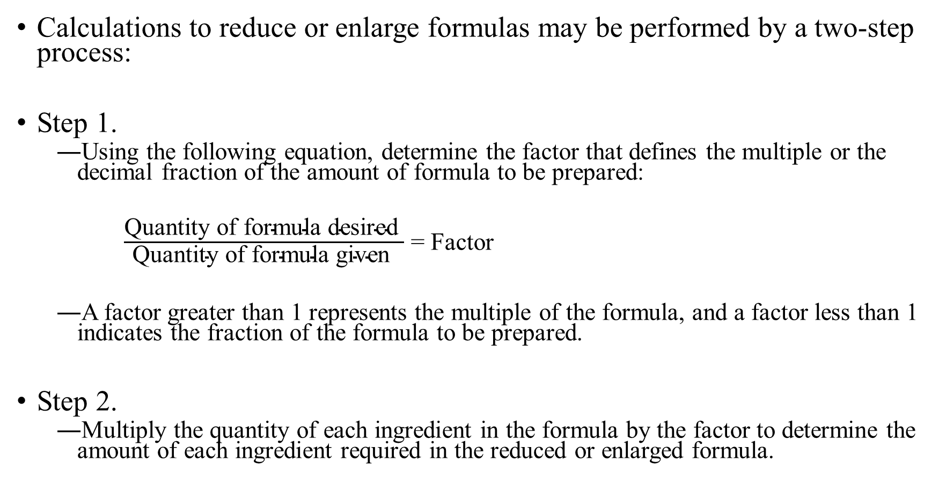
Enlarging and reducing formulas…

Slide 54
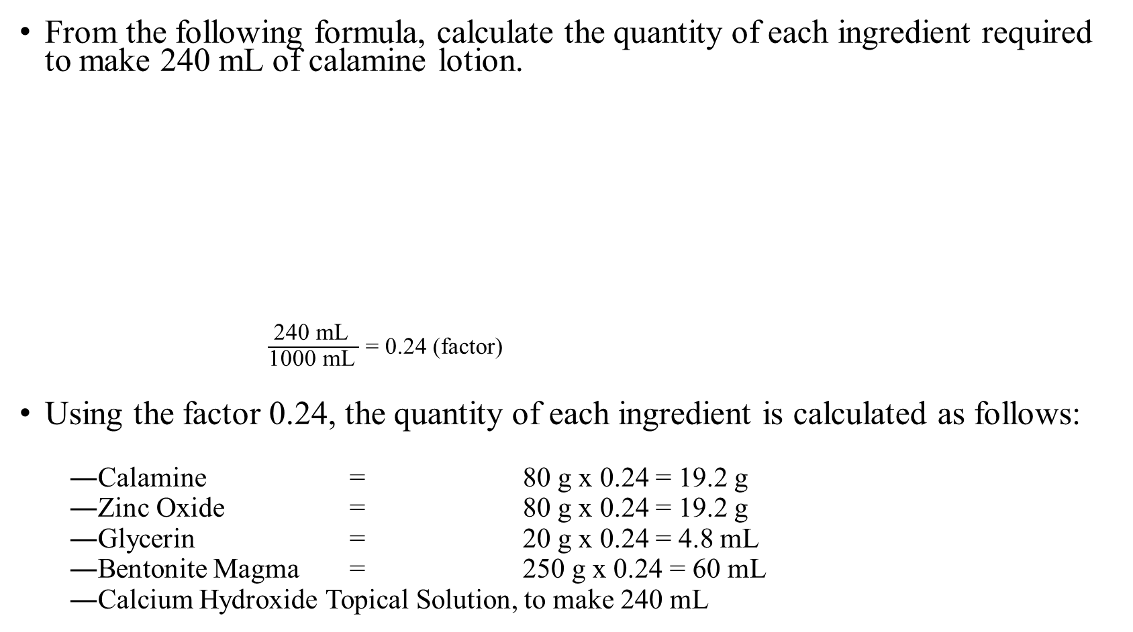
Enlarging and reducing formulas…
Master formula
Calamine 80 g
Zinc Oxide 80 g
Glycerin 20 g
Bentonite Magma 250 mL
Calcium Hydroxide Topical Solution, to make 1000 mL

Slide 55
Dilution and Concentration

Slide 56
Objective
At the end of this chapter, students will be able to:-
Perform calculations in Dilution and concentration of Drugs.
Prepare stock solutions and perform calculation related to stock solutions

Slide 57
Dilution and Concentration
The concentration of a solution is the amount of the dissolved substance (solute) per unit volume of solvent.
A solution can be diluted or concentrated
Relative terms, no cut point between them
Pharmaceutical preparation can be diluted
by addition of solvent or
by mixing with solution with lower concentration
The extent of dilution depend on the volume of solution with lower concentration

Slide 58
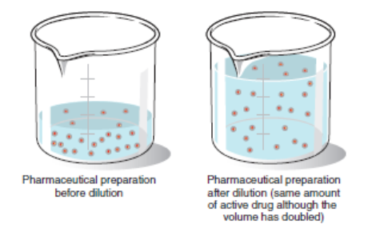

Slide 59
Dilution and Concentration…
Pharmaceutical preparation can be concentrated by
Addition of active ingredient
Admixture of solution with higher strength
Evaporation of continuous phase

Slide 60
Dilution and Concentration…
Stock Solutions
are concentrated solutions of active (e.g., drug) or inactive (e.g., colorant) substances and are used by pharmacists as a convenience to prepare solutions of lesser concentration
Example
How many milliliters of a 1% stock solution of a certified red dye should be used in preparing 4000 mL of a mouthwash that is to contain 1:20,000 w/v of the certified red dye as a coloring agent?
Given
C1 = 1%
C2 = 1:20,000 w/v = 0.005%
V2 = 4000 ml
Required
V1 = ?
Solution
C1xV1 = C2V2
V1 = C2xV2/C1
= 0.005% x4000 ml/1%
= 20 ml

Slide 61
Example: If 500 mL of a 15% v/v solution of methyl salicylate in alcohol is diluted to 1500 mL,what is the percentage strength v/v?
Given
Q1= 500mL, C1= 15%
Q2= 1500mL,
Req=C2?
Q1 * C1= Q2 * C2
500mL * 15% = 1500mL * C2
C2= 5%, answer

Slide 62
Dilution and Concentration…
Strength and total quantity
Strength
is the concentration of the active ingredient.
Total quantity
Is the total mass or volume of the dosage form
For example,
150 ml of 20% w/v solution
Strength 20% w/v
Total quantity = 150 ml
If the amount of active ingredient remains constant
Any change in the total quantity is inversely proportional to % strength

Slide 63
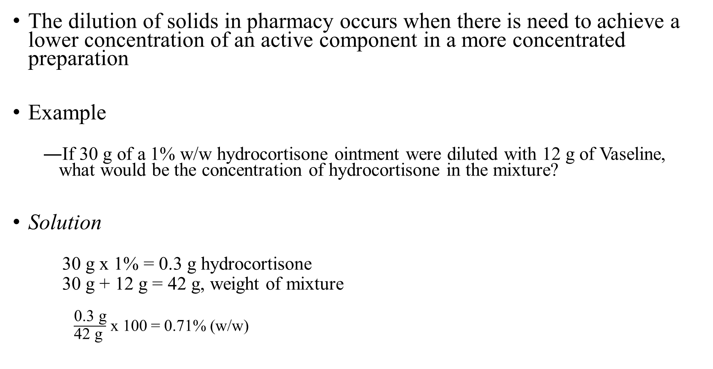
Dilution and concentration of Solids

Slide 64
Thank you!!!!!!

